Slide 1
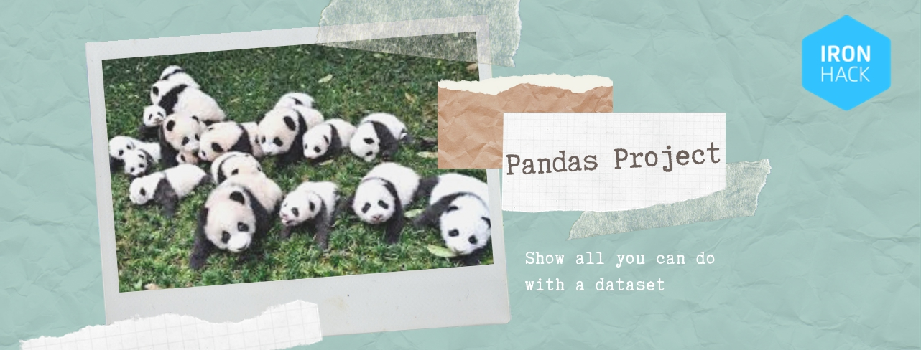
PROJECT 1- SHARKS ATTACKS
PROJECT 1 -SHARKS ATTACKS

Slide 2
Name’s having bad luck??
NAME | Num. attacks
John | 112
William | 73
Robert | 72
James | 64
David | 52

Slide 3
QUESTIONS TO BE ANSWERED:
ASFA
ASFA
ACTIVITY THAT THE PERSON WAS DOING
Activity with the highest attack rate
Activity with the highest mortality
3

Slide 4

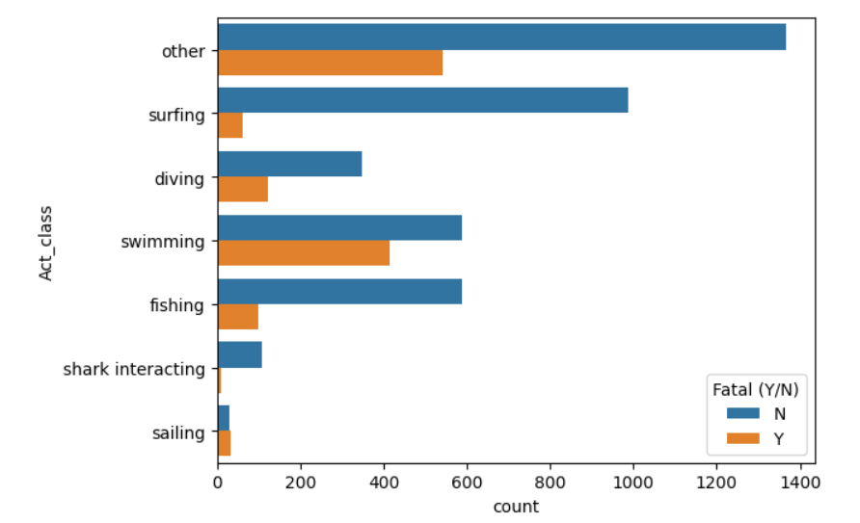
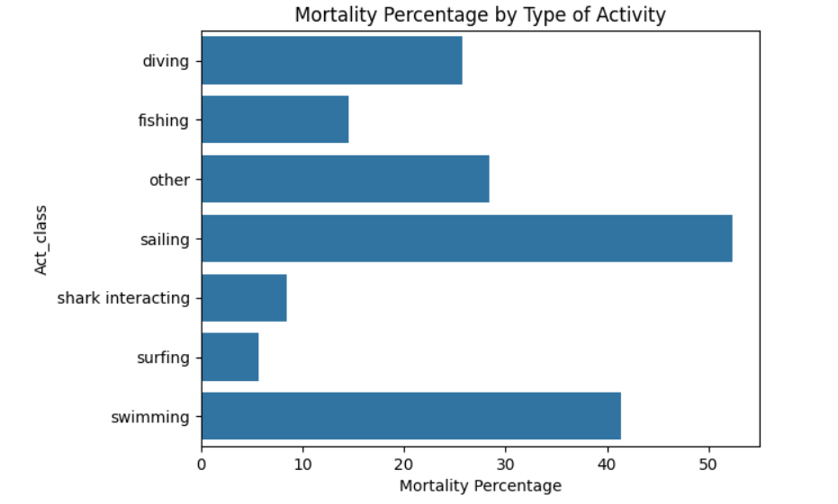
Activity with the highest attack rate
4

Slide 5
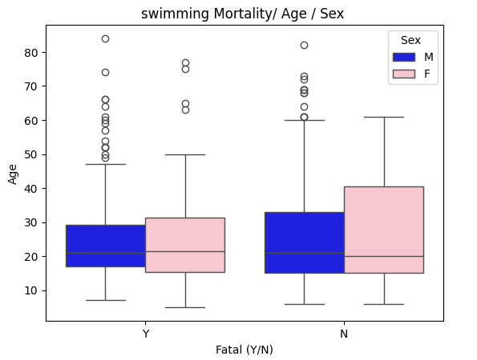
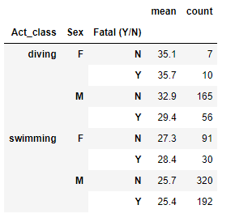
Is there a correlation between mortality and sex or age
5

